Slide 1
Working Progress

Slide 2
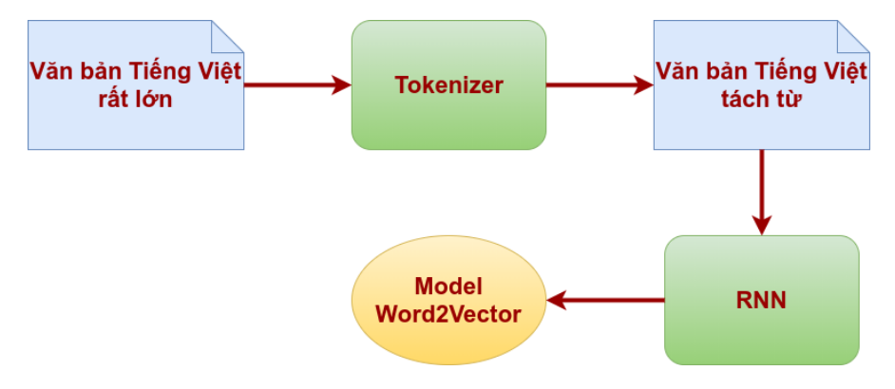
Word Embedding: Word2Vec Model

Slide 3
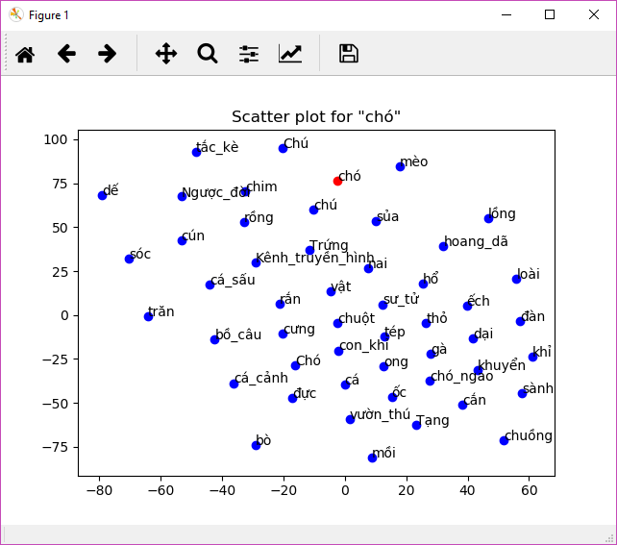

Slide 4
Data preprocessing
Input sequence: Đồ ăn ở đây rất ngon.
Integerized vector (with max sequence length = 10)
[ 735 264 25 126 75 2344 0 0 0 0]
We form a feature matrix of integerized vector for all the reviews in the dataset.
For example with 30000 reviews we will have a (Reviews x MaxSeqLen) feature matrix.
Choosing appropriate MaxSeqLen?

Slide 5
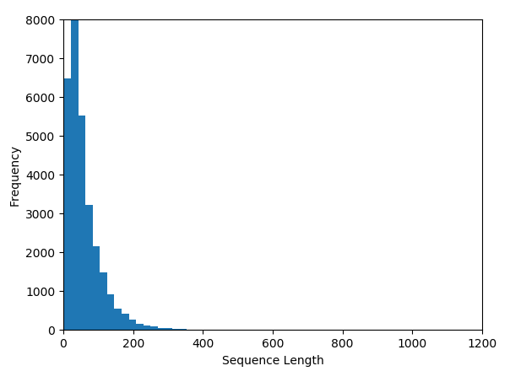
Here we will choose MaxSeqLen = 200 since it will cover most of the reviews’ length.
Reviews that have length greater than 200 will be truncate

Slide 6
Training Sentiment Analysis Model
Feature Matrix
LSTM
Sentiment Analysis Model
Embedding lookup
Word2Vec

